Slide 1
Clean & heal your world
Presented by “The Survivors”
Anita Joicy, Charaniya Ganesh, Elakkiya Balasubramanian, Mahima Meenakshi (Team Lead), Sheeba Varghese
FORD MOTORS PRIVATE LIMITED, CHENNAI, INDIA

Slide 2
PROBLEM STATEMENT & SHORT DESCRIPTION
The pandemic has opened our eyes on the importance of environment cleanliness. The country joined and is still attempting all possible opportunities to keep the environmental challenges at bay to enable a cleaner safer world. This has also driven that mindfulness of all actions that we do are going to shape our future and would probably be the only way to rope ourselves out of the pandemic. Keeping all of this in the per-view, we would like to propose a solution for Effective Waste Management and Maintenance – that aims at optimized disposal and pickup techniques for rural and urban India. The name of our proposal is “CLEAN & HEAL YOUR WORLD!.

Slide 3
ASSUMPTIONS
The area of implementations are SMART CITY SERVICES & CONNECTED
The Government of India is supportive of SMART CITY liaised solutions and the data is shared across all the platforms.
The proposed SMART Waste Management Application is a default application that is used across the base strata
The Property Tax Number becomes the primary key connecting the property to the surrounding trash locations viable for use.

Slide 4
LONG DESCRIPTION
The problem prevailing today denotes the absence of any system to dispose our waste. This has results in all varieties of infections besides COVID and has also made the Monsoons’ water clogging a bigger pain than pleasure. The proposed SMART Waste Management Application addresses the main problem by providing every house-hold resident an opportunity to find a spot for waster disposal and by not allowing any littering anywhere.
Every disposal bin in locked using a sensor panel. Every resident in each location is provided with a sensor key that allows him to
Understand which of the bins in the 1 km radius is available to take trash and nook a slot with the bin of choice to drop the trash.
On reaching the spot – he can open the trash only on using his mobile number registered in the application.
For every trash he drops into the bin correctly – he is awarded points
For every trash he litters he is fined via points which will calculated towards his property tax
For every organic trash which supports recycling – he is awarded additional points
All of the positive points add to value that is deducted off the annual tax due the following year.
The sensor is available per house per location and cannot be used across the locations.
Access management of the sensors is responsibility of the property owner.

Slide 5
LONG DESCRIPTION
Given that all of the trash is now sensor based – any mismatch/ malpractices/ criminal actions will be monitored and reviewed.
At the trash bins, once the trash bin is 80% full, the location is frozen, and the pick-up trucks are intimated of the same. This location will no longer active until the trash pick up is complete. Any further attempts in the same situations are controlled by the lock of the trash bin not unlocking.
User Registration to use the apps to be obtained by using the House Address
House Address validity can be verified using Property Tax ID

Slide 6
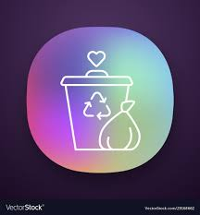
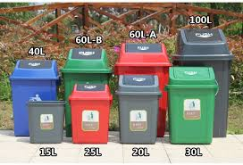
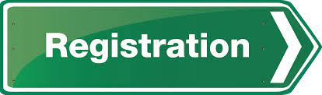

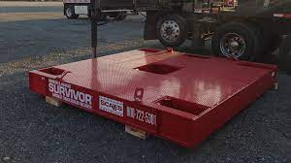

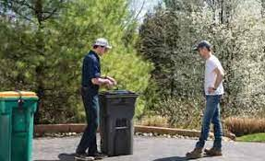
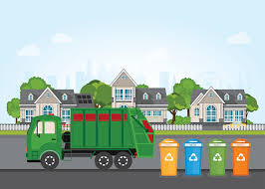
ARCHITECTURE DIAGRAM
Book slot for 15mins
Redeemable points to user wallet
Smart Waste Management App
Check for another slot
Check availability and bin capacity
Ask user to verify and book another slot.
Above Threshold
Check capacity
Within Threshold
Weight sensor to measure garbage quantity
Record collection data of user in IOT Cloud
Unlock Bin
Alert Garbage collectors.

Slide 7
FLOW CHART
Smart Waste Management App
Registration
Data for House Registration:
House Address.
Property Tax ID.
House Owner Name.
Register House
Community Bin Registration
Set capacity in IOT Cloud
User Register
Set Bin Threshold in IOT Cloud
Data for User Registration:
Name.
Select registered House Address.
Mobile Number.
Linked Wallet account number.
Verify Address validity
User enabled.
Redirect to House registration.

Slide 8
FLOW CHART
At the Garbage Dropbox
Enter registered mobile number
Book Slot to Drop Garbage
Log in Smart Waste Management App
User to place garbage in tray
Check bin availability
No
Weight sensor in Tray to measure Garbage quantity
Check alternate bins
Check bin available capacity
No
Capacity < Threshold
No
Unable to unlock bin
Yes
Yes
Book Drop Slot.
Book another slot
Unlock bin
Redeem point

Slide 9
IBM CALL OUTS/SERVICES
IBM API CONNECT
IOT CLOUD SERVICES
IBM WATSON AI
CONNECTED SENSORS

Slide 10
SOCIO-ECONOMIC BUSINESS VALUE PROPOSITION
A viable tax proposition to the property owners to help them pay their tax value at reduced prices at higher environmental consciousness
An attempt to streamline all the property-based taxes for the benefit of the country

